Slide 1

High Performance Joins
10/23/2023
Ahmedur Rahman Shovon
PhD student
Department of Computer Science
Email: ashov@uic.edu
Website: arshovon.com

Slide 2






Roadmap

Slide 3
Recap to Join operation

Slide 4
Recap to Relational Data
Relation
Relation: 2-dimensional structure
Attribute: Represents characteristics
Row: Represents unique record
Join (⨝): Combines data from relations
Projection (Π): Select specific columns
UserID | UserName | UserEmail
101 | Alice | alice@example.com
102 | Bob | bob@example.com
Tuple
(Row)
Attribute (Column)
Sidharth Kumar and Thomas Gilray. Distributed relational algebra at scale. In International Conference on High Performance Computing, Data, and Analytics (HiPC). IEEE, 2019.
Sidharth Kumar and Thomas Gilray. Load-balancing parallel relational algebra. In International Conference on High Performance Computing, pages 288–308. Springer, 2020.

Slide 5
Why Join is Important?
Combine data from multiple tables
Find patterns in data
Clean data
Create new data sets
Daniel Zinn, Haicheng Wu, Jin Wang, Molham Aref, and Sudhakar Yalamanchili. General-purpose join algorithms for large graph triangle listing on heterogeneous systems. In Proceedings of the 9th Annual Workshop on General Purpose Processing Using Graphics Processing Unit, pages 12–21, 2016.

Slide 6
Example of Natural Join ⨝
User (Outer Relation)
Order (Inner Relation)
UserID | UserName | UserEmail
101 | Alice | alice@example.com
102 | Bob | bob@example.com
103 | Eve | eve@example.com
UserID | OrderTotal | Items
103 | 25.69 | 2
102 | 145.66 | 3
101 | 12.11 | 1
103 | 44.00 | 2
⨝

Slide 7
Example of Natural Join ⨝
User (Outer Relation)
Order (Inner Relation)
UserID | UserName | UserEmail
101 | Alice | alice@example.com
102 | Bob | bob@example.com
103 | Eve | eve@example.com
UserID | OrderTotal | Items
103 | 25.69 | 2
102 | 145.66 | 3
101 | 12.11 | 1
103 | 44.00 | 2
⨝
User
Order
UserID | UserName | UserEmail | OrderTotal | Items
101 | Alice | alice@example.com | 12.11 | 1

Slide 8
Example of Natural Join ⨝
User (Outer Relation)
Order (Inner Relation)
UserID | UserName | UserEmail
101 | Alice | alice@example.com
102 | Bob | bob@example.com
103 | Eve | eve@example.com
UserID | OrderTotal | Items
103 | 25.69 | 2
102 | 145.66 | 3
101 | 12.11 | 1
103 | 44.00 | 2
⨝
User
Order
UserID | UserName | UserEmail | OrderTotal | Items
101 | Alice | alice@example.com | 12.11 | 1
102 | Bob | bob@example.com | 145.66 | 3

Slide 9
Example of Natural Join ⨝
User (Outer Relation)
Order (Inner Relation)
UserID | UserName | UserEmail
101 | Alice | alice@example.com
102 | Bob | bob@example.com
103 | Eve | eve@example.com
UserID | OrderTotal | Items
103 | 25.69 | 2
102 | 145.66 | 3
101 | 12.11 | 1
103 | 44.00 | 2
⨝
User
Order
UserID | UserName | UserEmail | OrderTotal | Items
101 | Alice | alice@example.com | 12.11 | 1
102 | Bob | bob@example.com | 145.66 | 3
103 | Eve | eve@example.com | 25.69 | 2

Slide 10
Example of Natural Join ⨝
User (Outer Relation)
Order (Inner Relation)
UserID | UserName | UserEmail
101 | Alice | alice@example.com
102 | Bob | bob@example.com
103 | Eve | eve@example.com
UserID | OrderTotal | Items
103 | 25.69 | 2
102 | 145.66 | 3
101 | 12.11 | 1
103 | 44.00 | 2
⨝
User
Order
UserID | UserName | UserEmail | OrderTotal | Items
101 | Alice | alice@example.com | 12.11 | 1
102 | Bob | bob@example.com | 145.66 | 3
103 | Eve | eve@example.com | 25.69 | 2
103 | Eve | eve@example.com | 44.00 | 2

Slide 11
Example of Natural Join ⨝
User (Outer Relation)
Order (Inner Relation)
UserID | UserName | UserEmail
101 | Alice | alice@example.com
102 | Bob | bob@example.com
103 | Eve | eve@example.com
UserID | OrderTotal | Items
103 | 25.69 | 2
102 | 145.66 | 3
101 | 12.11 | 1
103 | 44.00 | 2
⨝
User
Order
UserID | UserName | UserEmail | OrderTotal | Items
101 | Alice | alice@example.com | 12.11 | 1
102 | Bob | bob@example.com | 145.66 | 3
103 | Eve | eve@example.com | 25.69 | 2
103 | Eve | eve@example.com | 44.00 | 2

Slide 12
Duplicates on Join Result
User ⨝ Order
UserID | UserName | UserEmail | OrderTotal | Items
101 | Alice | alice@example.com | 12.11 | 1
102 | Bob | bob@example.com | 145.66 | 3
103 | Eve | eve@example.com | 26.69 | 2
103 | Eve | eve@example.com | 44.00 | 2
Π(_{UserName,UserEmail})(User ⨝ Order)
UserName | UserEmail
Alice | alice@example.com
Bob | bob@example.com
Eve | eve@example.com
Eve | eve@example.com

Slide 13
Join Algorithms

Slide 14
Join Algorithms
Common Algorithms
Hash Join (HJ)
NLJ is suitable for small dataset SMJ is efficient with pre-sorted data HJ works on unsorted datasets through hash-based partitioning
Sort-Merge Join (SMJ)
Nested Loop Join (NLJ)
Bingsheng He, Ke Yang, Rui Fang, Mian Lu, Naga Govindaraju, Qiong Luo, and Pedro Sander. Relational joins on graphics processors. In Proceedings of the 2008 ACM SIGMOD international conference on Management of data, pages 511–524, 2008.
Ran Rui, Hao Li, and Yi-Cheng Tu. Join algorithms on gpus: A revisit after seven years. In 2015 IEEE International Conference on Big Data (Big Data), pages 2541–2550. IEEE, 2015.

Slide 15
Nested Loop Join ⨝
Order (Inner Relation)
User (Outer Relation)
UserID | OrderTotal | Items
103 | 25.69 | 2
102 | 145.66 | 3
101 | 12.11 | 1
103 | 44.00 | 2
UserID | UserName | UserEmail
103 | Eve | eve@example.com
101 | Alice | alice@example.com
102 | Bob | bob@example.com
⨝
User
Order
UserID | UserName | UserEmail | OrderTotal | Items
103 | Eve | eve@example.com | 25.69 | 2
103 | Eve | eve@example.com | 44.00 | 2
101 | Alice | alice@example.com | 12.11 | 1
102 | Bob | bob@example.com | 145.66 | 3
Time complexity is O(N * M)

Slide 16
Example of Sort Merge Join ⨝
User (Outer Relation)
Order (Inner Relation)
UserID | UserName | UserEmail
103 | Eve | eve@example.com
101 | Alice | alice@example.com
102 | Bob | bob@example.com
UserID | OrderTotal | Items
103 | 25.69 | 2
102 | 145.66 | 3
101 | 12.11 | 1
103 | 44.00 | 2
Sort
Sort
User (Sorted)
Order (Sorted)
UserID | UserName | UserEmail
101 | Alice | alice@example.com
102 | Bob | bob@example.com
103 | Eve | eve@example.com
UserID | OrderTotal | Items
101 | 12.11 | 1
102 | 145.66 | 3
103 | 25.69 | 2
103 | 44.00 | 2

Slide 17
Example of Sort Merge Join ⨝
Order (Sorted)
User (Sorted)
Merge
UserID | OrderTotal | Items
101 | 25.69 | 2
102 | 145.66 | 3
103 | 12.11 | 1
103 | 44.00 | 2
UserID | UserName | UserEmail
101 | Alice | alice@example.com
102 | Bob | bob@example.com
103 | Eve | eve@example.com
⨝
User
Order
UserID | UserName | UserEmail | OrderTotal | Items
101 | Alice | alice@example.com | 12.11 | 1
102 | Bob | bob@example.com | 145.66 | 3
103 | Eve | eve@example.com | 25.69 | 2
103 | Eve | eve@example.com | 44.00 | 2
Time complexity: O(N * log(N)) + O(M * log(M)) (sorting) + O(N + M) (merging)

Slide 18
Example of Hash Join ⨝
User (HashTable)
User (Outer Relation)
Order (Inner Relation)
UserID | UserName | UserEmail
102 | Bob | bob@example.com
101 | Alice | alice@example.com
103 | Eve | eve@example.com
UserID | OrderTotal | Items
103 | 25.69 | 2
102 | 145.66 | 3
101 | 12.11 | 1
103 | 44.00 | 2
UserID | UserName | UserEmail
103 | Eve | eve@example.com
101 | Alice | alice@example.com
102 | Bob | bob@example.com
Build
Probe
⨝
User
Order
UserID | UserName | UserEmail | OrderTotal | Items
103 | Eve | eve@example.com | 25.69 | 2
103 | Eve | eve@example.com | 44.00 | 2
101 | Alice | alice@example.com | 12.11 | 1
102 | Bob | bob@example.com | 145.66 | 3
Time complexity is O(M) + O(N) (building and probing hash table)

Slide 19
Incremental Works

Slide 20
Our efforts on High Performance Relational Algebra
cuDF
Started with CPU and GPU based Python libraries
Compare GPU capabilities for iterative join operations
GPUJoin
Relational Algebra (RA) operations using CUDA
High performance GPU hashtable for iterative RA
GDLog
CUDA based SIMD API for deductive analytics
Novel Hash-Indexed Sorted Array data structure
mnmgJoin
Multi node multi GPU based engine
CUDA + MPI based design (Work in progress )
A. R. Shovon, L. R. Dyken, O. Green, T. Gilray and S. Kumar, "Accelerating Datalog applications with cuDF," 2022 IEEE/ACM Workshop on Irregular Applications: Architectures and Algorithms (IA3), Dallas, TX, USA, 2022, pp. 41-45
Team, R. D. (2018). RAPIDS: Collection of libraries for end to end GPU data science. NVIDIA, Santa Clara, CA, USA. https://rapids.ai
Shovon, A. R., Gilray, T., Micinski, K., & Kumar, S. (2023). Towards iterative relational algebra on the {GPU}. In 2023 USENIX Annual Technical Conference (USENIX ATC 23) (pp. 1009-1016).

Slide 21

Baseline Engine (Soufflé)
A state-of-the art in-memory engine
Uses CPU-based multi-core system for parallel execution of RA operations
Herbert Jordan, Bernhard Scholz, and Pavle Subotić. 2016. Soufflé: On synthesis of program analyzers. In Computer Aided Verification: 28th International Conference, CAV 2016, Toronto, ON, Canada, July 17-23, 2016, Proceedings, Part II 28. Springer, 422–430

Slide 22
Off-the-shelf Library

Slide 23
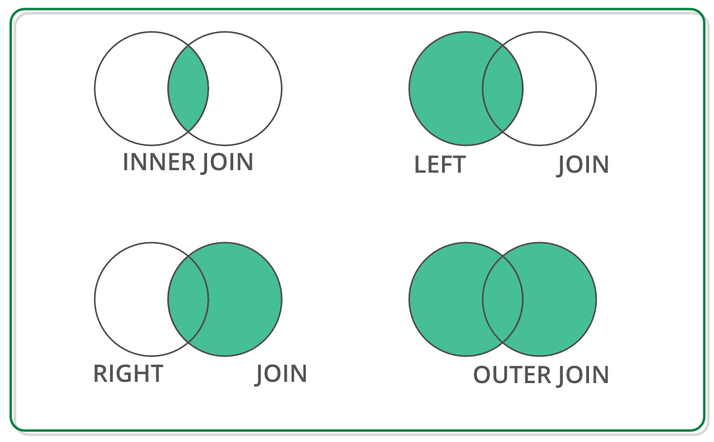
Off-the-shelf Data Structure for Join Operation
DataFrame has RA primitives APIs
DataFrame: 2D labeled tabular data structure
Reback, J., McKinney, W., Van Den Bossche, J., Augspurger, T., Cloud, P., Klein, A., ... & Seabold, S. (2020). pandas-dev/pandas: Pandas 1.0. 5. Zenodo.
Chen, D. Y. (2017). Pandas for everyone: Python data analysis. Addison-Wesley Professional.
Singh, R. (2020, July 1). Merging DataFrames with Pandas: Pd.merge(). Medium. Retrieved April 8, 2023, from https://medium.com/swlh/merging-dataframes-with-pandas-pd-merge-7764c7e2d46d

Slide 24


Off-the-shelf Python Libraries
DataFrame: 2D labeled tabular data structure
GPU (NVIDIA cuDF)
CPU
Both supports join operation with similar APIs
Reback, J., McKinney, W., Van Den Bossche, J., Augspurger, T., Cloud, P., Klein, A., ... & Seabold, S. (2020). pandas-dev/pandas: Pandas 1.0. 5. Zenodo.
Chen, D. Y. (2017). Pandas for everyone: Python data analysis. Addison-Wesley Professional.
Green, O., Du, Z., Patel, S., Xie, Z., Liu, H., & Bader, D. A. (2021, December). Anti-Section Transitive Closure. In 2021 IEEE 28th International Conference on High Performance Computing, Data, and Analytics (HiPC) (pp. 192-201). IEEE.
Fender, A., Rees, B., & Eaton, J. RAPIDS cuGraph. In Massive Graph Analytics (pp. 483-493). Chapman and Hall/CRC.

Slide 25
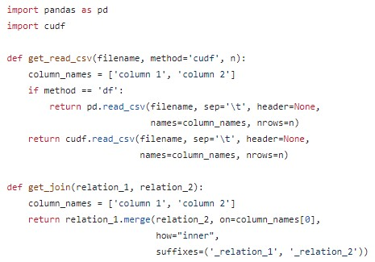
CPU (Pandas) and GPU (cuDF)
CPU Environment
GPU Environment
https://github.com/harp-lab/GPUJoin/edit/main/IA3_2022/basic_operations.py

Slide 26
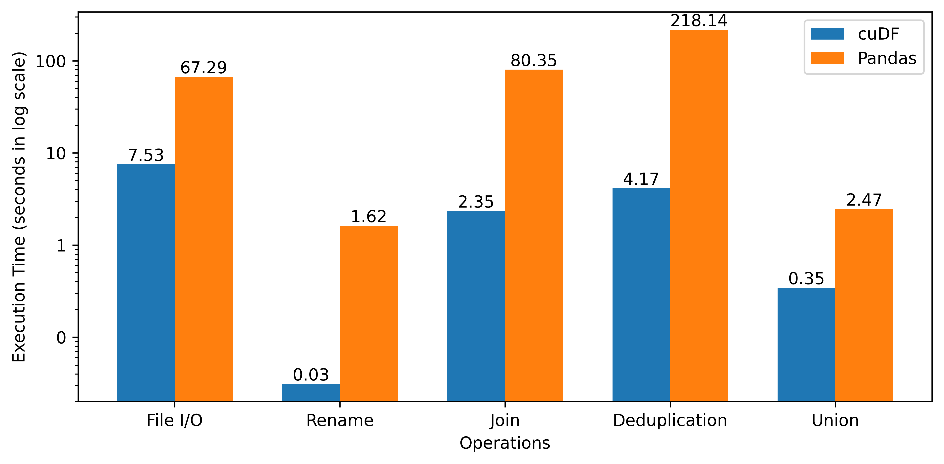
Performance Improvement of using GPU
https://github.com/harp-lab/GPUJoin/edit/main/IA3_2022/basic_operations.py

Slide 27
DataFrame Based Join Operations
Advantages
Abstract memory management
Abstract thread block configuration
Same API signatures for CPU and GPU
Easy-to-code interface
A. R. Shovon, L. R. Dyken, O. Green, T. Gilray and S. Kumar, "Accelerating Datalog applications with cuDF," 2022 IEEE/ACM Workshop on Irregular Applications: Architectures and Algorithms (IA3), Dallas, TX, USA, 2022, pp. 41-45
Green, O., Du, Z., Patel, S., Xie, Z., Liu, H., & Bader, D. A. (2021, December). Anti-Section Transitive Closure. In 2021 IEEE 28th International Conference on High Performance Computing, Data, and Analytics (HiPC) (pp. 192-201). IEEE.
Team, R. D. (2018). RAPIDS: Collection of libraries for end to end GPU data science. NVIDIA, Santa Clara, CA, USA. https://rapids.ai

Slide 28
Improvement Opportunity
Open-addressing based hashtable
Fuse join and projection
Sorted results for deduplication
Pinned memory scheme
Intermediate memory clearance
A. R. Shovon, L. R. Dyken, O. Green, T. Gilray and S. Kumar, "Accelerating Datalog applications with cuDF," 2022 IEEE/ACM Workshop on Irregular Applications: Architectures and Algorithms (IA3), Dallas, TX, USA, 2022, pp. 41-45
Green, O., Du, Z., Patel, S., Xie, Z., Liu, H., & Bader, D. A. (2021, December). Anti-Section Transitive Closure. In 2021 IEEE 28th International Conference on High Performance Computing, Data, and Analytics (HiPC) (pp. 192-201). IEEE.

Slide 29
Low level Hash Join implementation

Slide 30
Hash Join Process
Outer
Relation
Hash Table
35
44
11
23
11
23
. . .
. . .
46
31
46
31
. . .
97
32
35
44
Key - Value
97
32
Key - Value

Slide 31
Hash Join Process
Hash Join Relation
With
Duplicate records
Hash Join Relation
With
Duplicate records
⨝
Hash Table
Inner
Relation
Deduplicated records
Deduplication

Slide 32
Hash Table (Open Addressing, Linear Probing)
Grid Stride Loop
0
1
...
511
. . .
Block 0
35
44
11
23
. . .
. . .
0
1
...
511
46
31
. . .
Block n
97
32
CUDA Threads
Key - Value
Hash Table
Key-Value Pair

Slide 33
Hash Table (Open Addressing, Linear Probing)
Grid Stride Loop
Murmur 3 hashing
0
1
...
511
35
44
. . .
Block 0
35
44
11
23
11
23
. . .
. . .
0
1
...
511
AtomicCAS
46
31
. . .
Block n
97
32
CUDA Threads
Key - Value
Hash Table
Key-Value Pair

Slide 34
Hash Table (Open Addressing, Linear Probing)
Grid Stride Loop
Murmur 3 hashing
0
1
...
511
35
44
. . .
Block 0
35
44
11
23
11
23
. . .
. . .
0
1
...
511
AtomicCAS
46
31
. . .
Block n
97
32
CUDA Threads
Key - Value
Hash Table
Key-Value Pair

Slide 35
Hash Table (Open Addressing, Linear Probing)
Grid Stride Loop
Murmur 3 hashing
0
1
...
511
35
44
. . .
Block 0
35
44
11
23
11
23
. . .
. . .
0
1
...
511
AtomicCAS
46
31
. . .
Block n
97
32
CUDA Threads
Key - Value
Hash Table
Key-Value Pair

Slide 36
Hash Table (Open Addressing, Linear Probing)
Grid Stride Loop
Murmur 3 hashing
0
1
...
511
35
44
. . .
Block 0
35
44
11
23
11
23
. . .
. . .
0
1
...
511
AtomicCAS
46
31
. . .
Block n
97
32
Collision -> Linear probing (Position + 1) & hash table size
CUDA Threads
Key - Value
Hash Table
Key-Value Pair

Slide 37
Hash Table (Open Addressing, Linear Probing)
Grid Stride Loop
Murmur 3 hashing
0
1
...
511
35
44
. . .
Block 0
35
44
11
23
11
23
. . .
. . .
0
1
...
511
AtomicCAS
46
31
. . .
Block n
46
31
97
32
Collision -> Linear probing (Position + 1) & hash table size
97
32
CUDA Threads
Key - Value
Hash Table
Key-Value Pair

Slide 38
Hash Table (Open Addressing, Linear Probing)
Stores key-value pairs in sparse space
Uses extra memory
Grid Stride Loop
Murmur 3 hashing
0
1
...
511
35
44
. . .
Block 0
35
44
11
23
11
23
. . .
. . .
0
1
...
511
AtomicCAS
46
31
. . .
Block n
46
31
97
32
Collision -> Linear probing (Position + 1) & hash table size
97
32
CUDA Threads
Key - Value
Hash Table
Key-Value Pair

Slide 39
How can we improve this?

Slide 40
Hash Indexed Sorted Array (HISA)
Enable fast lookups
Reduce memory
Grid Stride Loop
Murmur 3 hashing
0
1
...
511
*11
. . .
Block 0
35
44
11
23
*35
35
44
. . .
11
23
. . .
0
1
...
511
AtomicCAS
46
31
46
31
. . .
97
32
Block n
*46
97
32
Collision -> Linear probing (Position + 1) & hash table size
*97
Compact
Data Array
CUDA Threads
Key - Value
Sorted Index Map

Slide 41
Hash Table Performance
Build rate:
Random synthetic graph: 400 million keys/second
String graph: 4 billion keys/second
Load factors are varied to ensure less memory overhead

Slide 42
Performing Hash Join on GPU
Static Hash Table
Inner Relation
Key | Value
Key | Value
Calculate join size
⨝
First pass

Slide 43
Performing Hash Join on GPU
Static Hash Table
Inner Relation
Key | Value
Key | Value
Calculate join size
⨝
First pass
Prefix sum
Join Result
Second pass
(fused projection)
Join Key | Value 1 | Value 2

Slide 44
Performing Hash Join on GPU
Static Hash Table
Inner Relation
Key | Value
Key | Value
Calculate join size
⨝
First pass
Prefix sum
Join Result
Second pass
(fused projection)
Join Key | Value 1 | Value 2
Sort and Unique
Deduplicated Join Result
Key | Value

Slide 45
Benchmarks

Slide 46
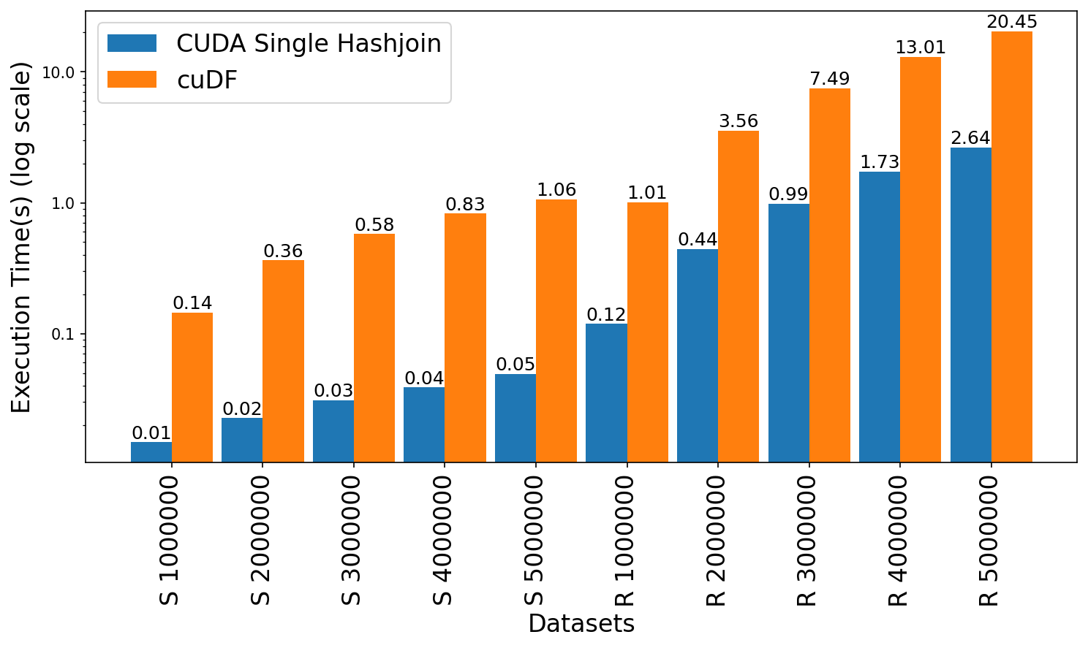
Join Performance Comparison: GPUJoin vs cuDF
Leadership Computing Facility, A. (2022). Argonne Leadership Computing Facility. Theta GPU Nodes. URL: https://www.alcf.anl.gov/support-center/theta-gpu-nodes
Notes:
Observe up to 21x speedup for string graph
Observe 7.6x to 8.4x speedup for random graph

Slide 47
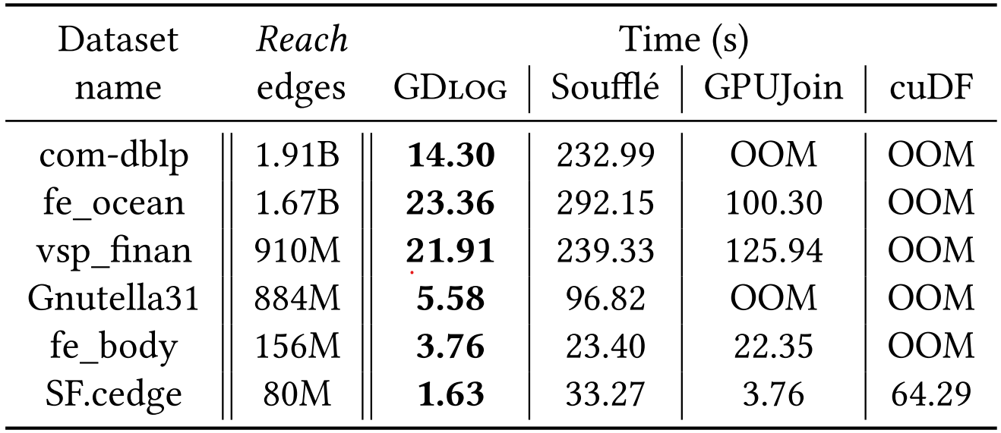
Performance Enhancement (Reachability)

Slide 48

Limitations
Limited to a single GPU that dictates scaling by available VRAM on the GPU
Memory overflow error for larger graphs

Slide 49
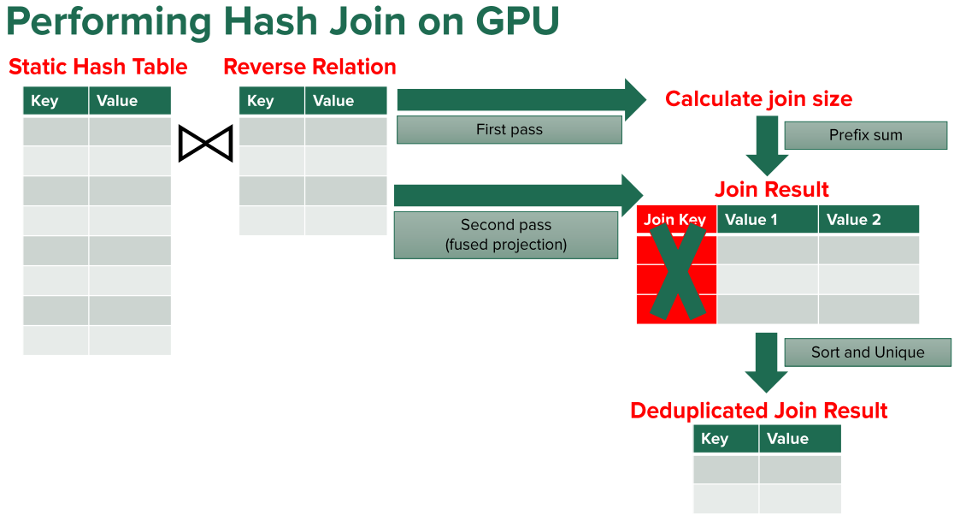
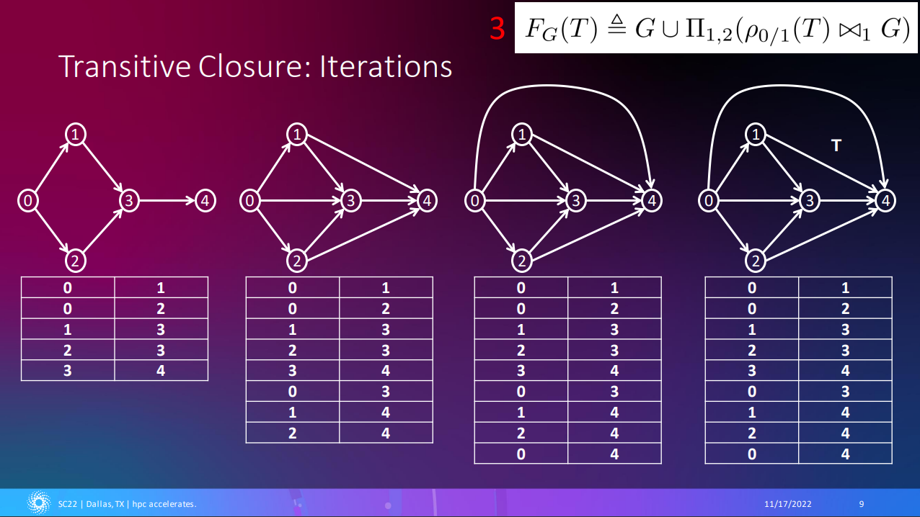
Publications
Shovon, A. R., Gilray, T., Micinski, K., & Kumar, S. (2023). Towards iterative relational algebra on the {GPU}. In 2023 USENIX Annual Technical Conference (USENIX ATC 23) (pp. 1009-1016).
Shovon, A. R., Dyken, L. R., Green, O., Gilray, T., & Kumar, S. (2022, November). Accelerating Datalog applications with cuDF. In 2022 IEEE/ACM Workshop on Irregular Applications: Architectures and Algorithms (IA3) (pp. 41-45). IEEE.

Slide 50
Future Work
Continue working on developing multi-node multi-GPU backend for Datalog
Compare performance between CUDA + MPI backend with CUDA aware MPI backend
Design GPU benchmarking techniques for iterative RA

Slide 51
Thank You
ashov@uic.edu

Slide 52
Declarative Analytics on Heterogeneous Exascale Systems
Users expresses what to achieve with the data rather than how to accomplish it
User
UserID | UserName | UserEmail | Country
101 | Alice | alice@example.com | USA
102 | Bob | bob@example.com | USA
103 | Eve | eve@example.com | Australia
WHAT
HOW
SELECT UserID FROM User WHERE Country = 'USA';
Advanced approach: Logic programming (Datalog)
Makrynioti, N., & Vassalos, V. (2019). Declarative data analytics: A survey. IEEE Transactions on Knowledge and Data Engineering, 33(6), 2392-2411.
Salesforce. (2024). Click, Not Code: The Benefits of Declarative Programming vs. Imperative Programming retrieved from https://www.salesforce.com/products/platform/best-practices/declarative-programming-vs-imperative-programming/ on 01/24/2026

Slide 53

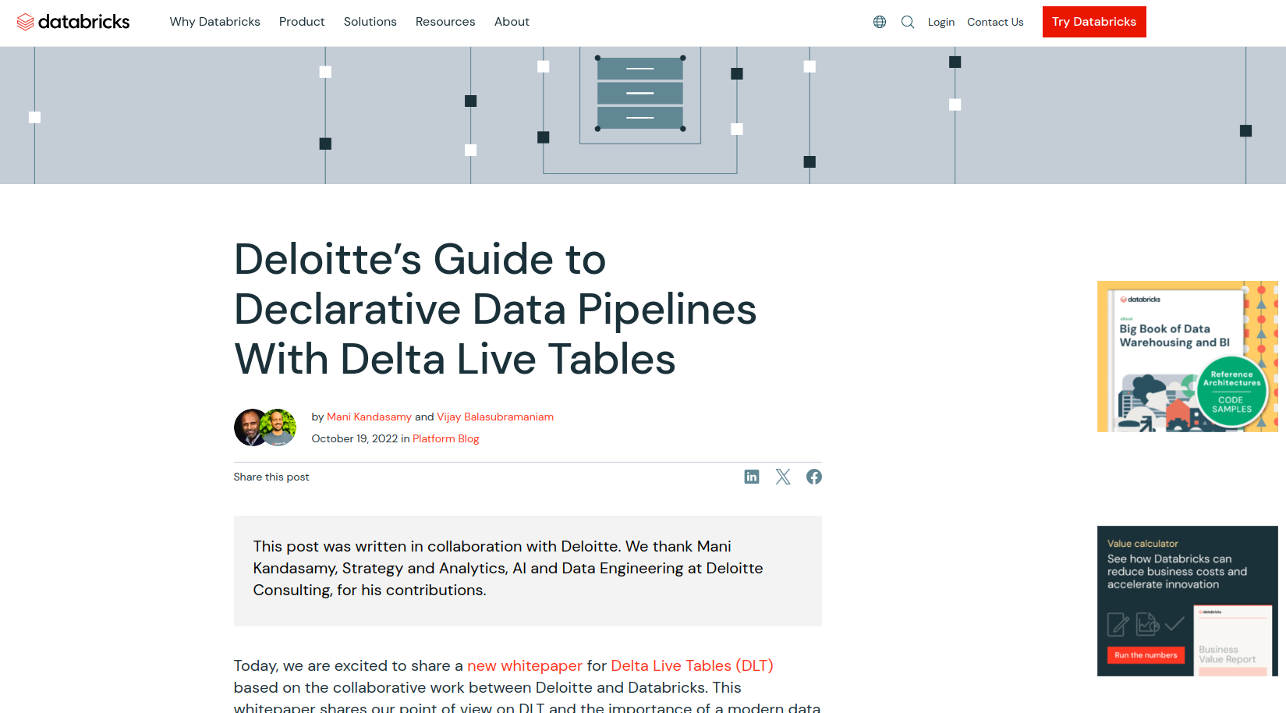

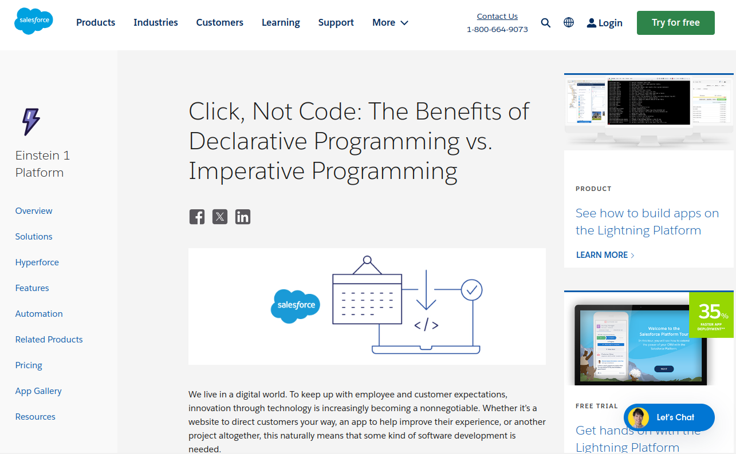
Declarative Analytics on Heterogeneous Exascale Systems
Enables drag-and-drop like analytics pipeline to make informed business decisions without the need for complex coding
Makrynioti, N., & Vassalos, V. (2019). Declarative data analytics: A survey. IEEE Transactions on Knowledge and Data Engineering, 33(6), 2392-2411.
Salesforce. (2024). Click, Not Code: The Benefits of Declarative Programming vs. Imperative Programming retrieved from https://www.salesforce.com/products/platform/best-practices/declarative-programming-vs-imperative-programming/ on 01/24/2026

